Slide 1

Cloud Based Platformer Game Level Editor
Politeknik Elektronika Negeri Surabaya
Game Technology
Advisor:
Rizky Yuniar Hakkun, S.Kom, MT. NIP 198106222008121003
Kholid Fathoni, S.Kom, MT.
NIP 1980012262008121003
By:
Titan Adi Narendra 4210171017

Slide 2
Background
The importance of level design in platformer games.
A simple and easy to use level editor for platformer games.
Implementing cloud service to Level editor.

Slide 3
Problems
How to build a platformer games level editor?
How to implement cloud services for designing and sharing levels?

Slide 4
Goals
To build a simple and easy to use platformer level editor.
Share, edit and design one's or other's levels.

Slide 5
Scope of Problems
Web based level editor.
Level editor for 2D platformer games only.
Tools and features are limited to terrain , character, items and obstacle editor.

Slide 6
Why Platformer Games
Platformer games need a good level design, for:
The main levels designed to has a stable increasing difficulty.
But bonus level has a higher difficulty with spikes.
In conclusion, level design is needed to create a suitable difficulty according to the level, whether to make it easy or challenging.

Slide 7
Methodology
01
03
05
02
04
06
Research
Production
Beta
Research for interface and tools in level editor.
Design
Testing
Game tested using a selected group of player before full release.
Release
Build and create level editor based from the design using Phaser and Node.js
Design use case diagram, wireframe and mockup.
Testing for User Interface, tools and cloud services in level editor.
Game released after confirmed ready from beta test.

Slide 8
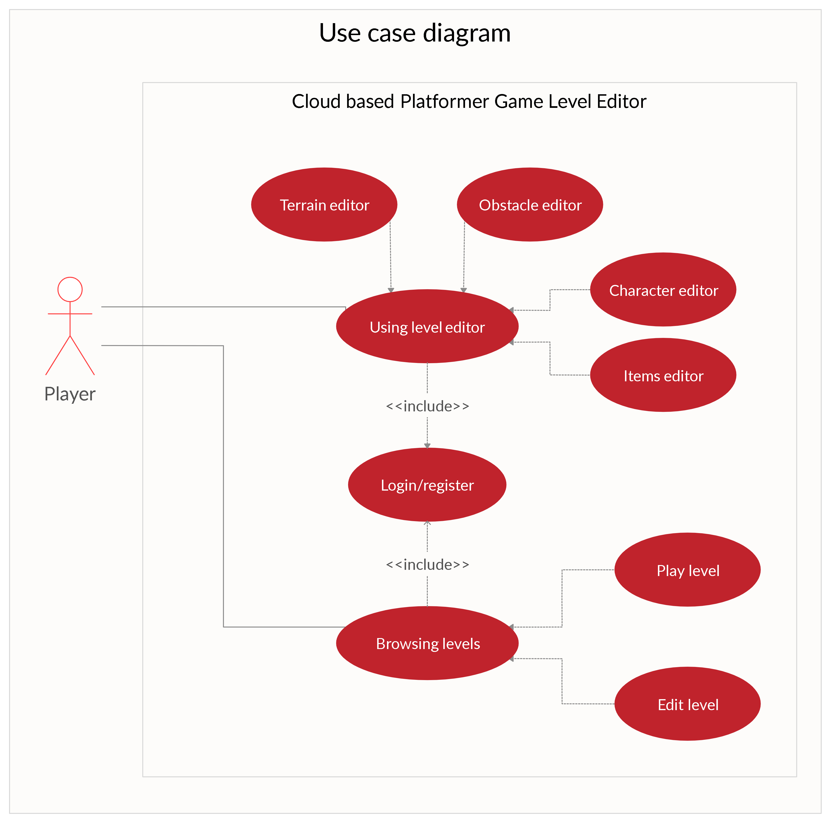
Use Case Diagram

Slide 9
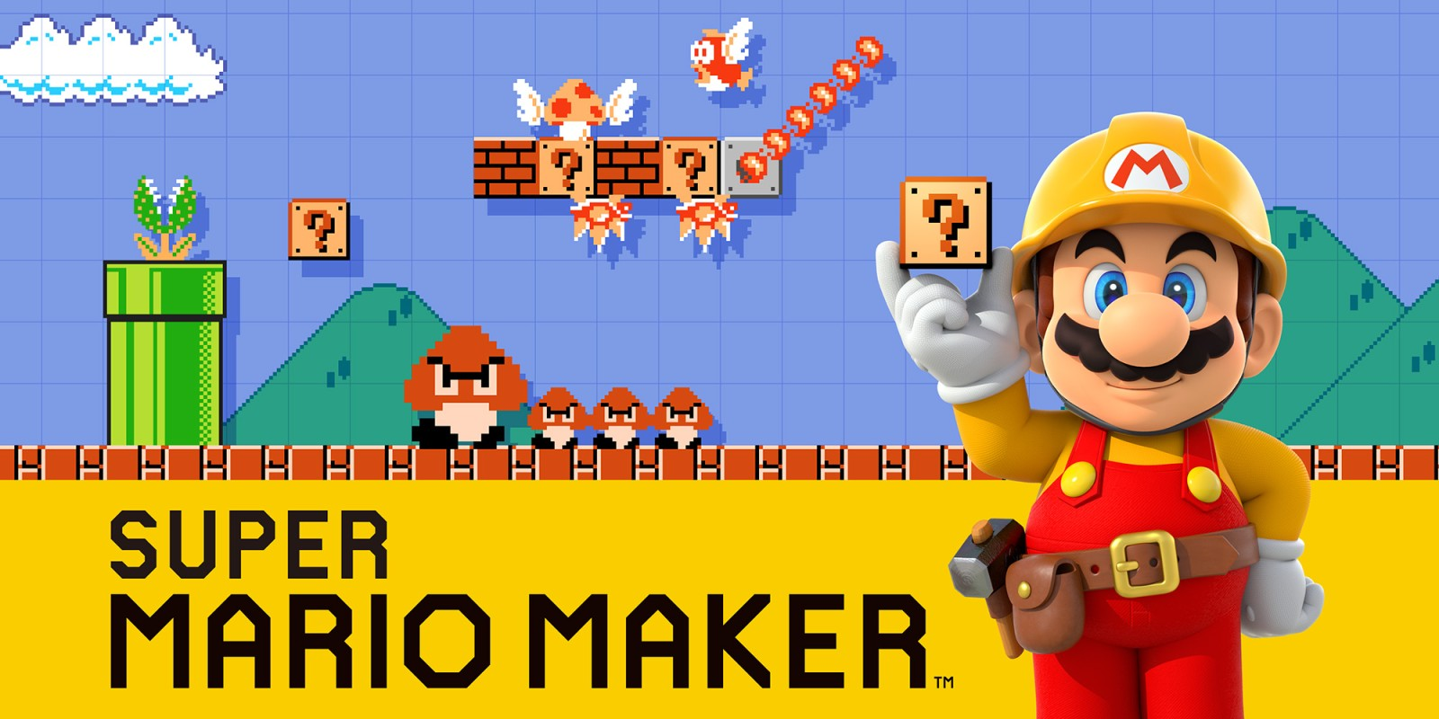
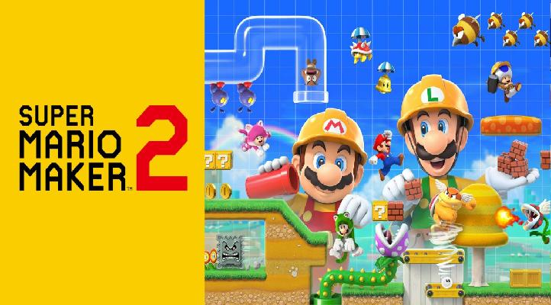
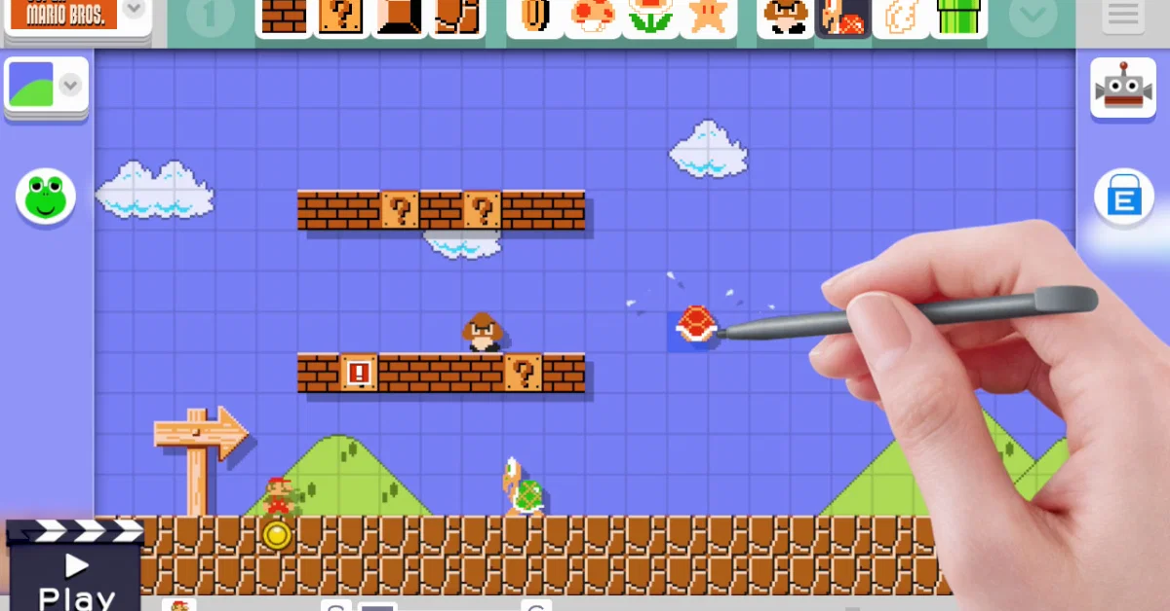
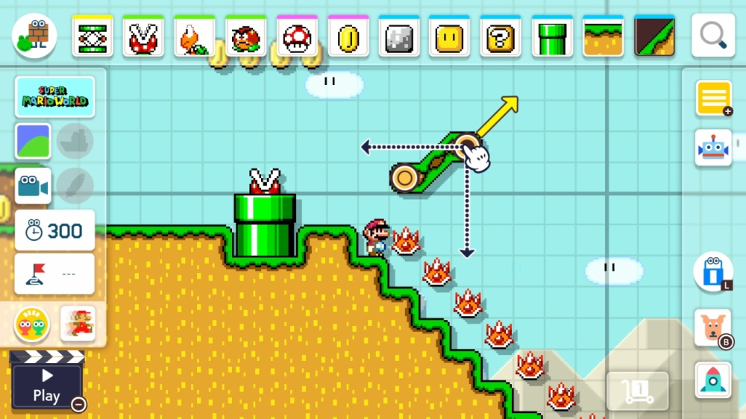
Existing Games

Slide 10
Reference
Minkkinen, T. (2016). Basics of Platform Games. Basics of Platform Games, 2-3.
A. Khalifa, F. de Mesentier Silva and J. Togelius, Level Design Patterns in 2D Games, 2019 IEEE Conference on Games (CoG), London, United Kingdom, 2019, 1-8.
Computer Hope, What is a Level Editor?. 18 May, 2020, from https://www.computerhope.com/jargon/l/level-editor.htm
Mell, P., & Grance, T. (2011). The NIST definition of cloud computing. The NIST definition of cloud computing, 2-3.
Hakkun, R. Y., Dio Al Sabah, A. Z., Fathoni, K., Ramadijanti, N., & Basuki, A. (2018, October). Online Visual Novel Game Framework. In 2018 International Conference on Information and Communication Technology Convergence (ICTC) (pp. 166-170). IEEE.

Slide 11
Thank you

